Slide 1


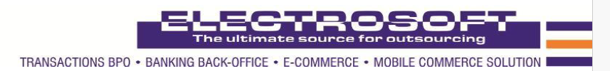
CHANDUBHAI S PATEL INSTITUTE OF TECHNOLOGY
DEPARTMENT OF COMPUTER SCIENCE AND ENGINEERING
CSE401- PROJECT MINOR
Project Title: Customer Preference and Trend Analytics for Retail Sector
(July 2026 to November 2026)
Prepared By
External Guide(s)
Internal Guide(s)
Pranav Patel(22cs060)
Mr. Divyang Shah
CEO and Founder
Electrosoft
Prof. Akshita Kadam
Assistant Professor
CSPIT-CSE

Slide 2





THE BUSINESS PROBLEM
Data Overload: The company possesses over 293,000 raw transaction records, containing critical data points on customer behavior, product mix, and logistics.
Inconsistency & Inaccuracy: The source data suffers from significant quality issues, null values, date format issues including conflicting customer demographics (e.g., gender, income) tied to the same Customer ID, leading to incorrect reporting.
The Gap: Without a robust, visual analytical system, key seasonal dips, top customer profiles, and operational failures remain hidden, preventing strategic, data-driven decisions.
Key Question to Answer: How do we clean, model, and analyze this data to drive measurable improvements in revenue and customer satisfaction?

Slide 3

PROJECT OBJECTIVES (STAKEHOLDER GOALS)
We designed this project to meet core business goals that directly impact the bottom line:
Maximize Customer Loyalty: Identify the exact profile of the repeat customer (demographics, product preference) to inform retention campaigns.
Optimize Product Strategy: Determine the true Volume vs. Value dynamic (e.g., why is a low-value brand like Pepsi the top seller?) and align product marketing accordingly.
Drive Consistent Revenue: Uncover and provide countermeasures for negative seasonal trends (e.g., the February Sales Dip).
Enhance Operational Quality: Pinpoint the root cause of negative feedback, especially post-delivery issues, to improve service reputation.
Target KPI Improvement: Deliver strategic recommendations capable of improving Customer Lifetime Value (CLV) and reducing the negative feedback rate.

Slide 4






METHODOLOGY & TOOLS
2.Data Cleaning & Preprocessing (Python)
3.Exploratory Data Analysis (EDA) in Python
1. Data Collection
5. Insight Extraction via SQL
Collected 2,93,000 transaction and customer records
Customer Segmentation
Sales and product trends
Time-based insights
Top products, cities
Revenue by region
Repeat customer logic
Data validation
Handle nulls
Handle duplicates
Format date & time
Standardize columns
7. Report & Business Insights
6. Dashboard Creation in Power BI
Sales overview
Customer behavior
Operational KPIs
Recommendations
Visual summaries

Slide 5

EXECUTIVE SUMMARY
Objective: To analyze a retail dataset of over 293,000 transactions to identify key business drivers and provide actionable recommendations.
Key Findings:
Identified a significant 68% repeat customer rate, with loyalty driven by the 18-25 age demographic.
Uncovered a -7.3% sales dip in February, directly linked to a drop in customer traffic.
Revealed that the USA is the dominant market, with success driven by a focus on high-volume Grocery items.
Discovered that 14% "Bad" feedback is primarily linked to post-delivery issues, not just fulfillment speed.
Business Impact: The analysis provides a clear roadmap to increase customer retention, optimize regional marketing, and improve operational efficiency.

Slide 6
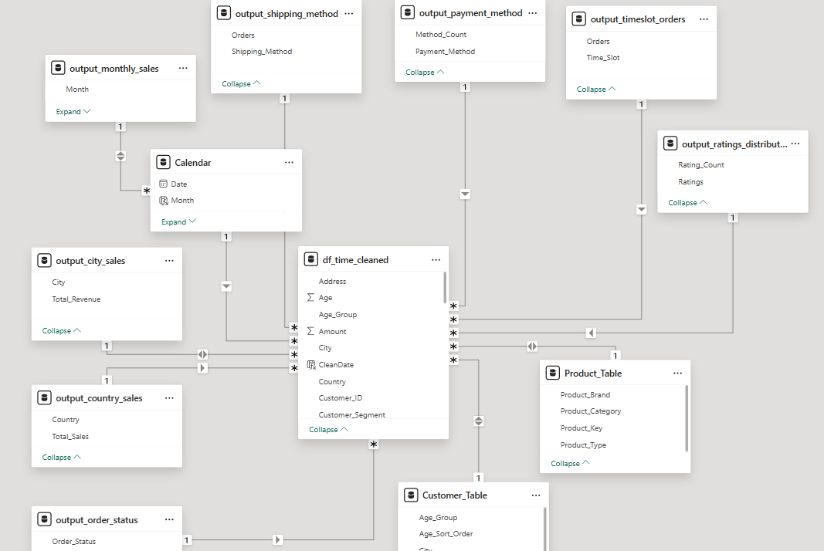
PROJECT OVERVIEW & METHODOLOGY
A brief, 4-step workflow diagram:
Data Cleaning (Python): Processed and cleaned a 293K-record dataset.
SQL Analysis: Performed diagnostics and aggregations.
Data Modeling (Power BI): Built a robust star schema with clean Customer and Product dimension tables to resolve data inconsistencies.
Dashboarding & Analysis: Developed 4 interactive dashboards and conducted root cause analysis.

Slide 7
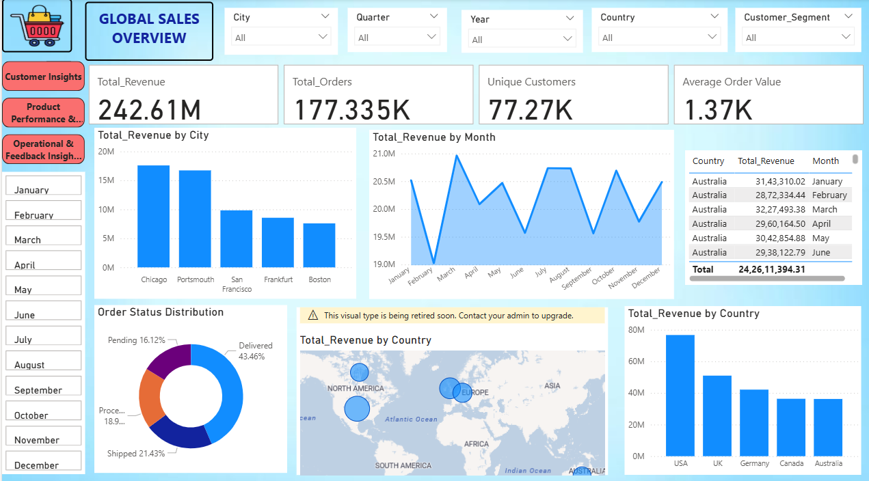
DASHBOARD 1 - GLOBAL SALES OVERVIEW
This dashboard provides a high-level summary of business health.
Key KPIs:
Total Revenue: $242.61M
Total Orders: 177.3K
Unique Customers: 77.27K

Slide 8
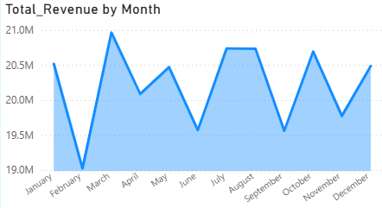
WHY DO SALES DROP IN FEBRUARY?
The "What": The data shows a consistent -7.3% drop in revenue every February.
The "Why": Investigation revealed this is not due to lower spending (Average Order Value actually increased slightly). The root cause is a -7.8% drop in unique customer traffic during that month.
Recommendation: Launch targeted marketing campaigns in late January to boost customer engagement and traffic during this historically weak period.

Slide 9
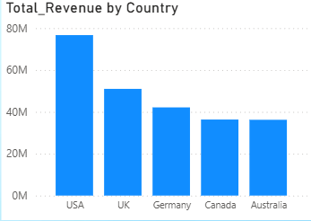
THE USA MARKET SUCCESS
The "What": The USA is the dominant market by a significant margin.
The "Why": Its success is driven by a large, loyal base of 'Regular' customers in the 18-35 age group. Crucially, their top product category is Grocery, not Electronics, indicating a preference for high-volume, everyday items. Operational performance is average, not a key driver of success.
Recommendation: To grow other markets, test campaigns that focus on building loyalty through high-volume grocery and everyday items, targeted at a younger demographic.

Slide 10
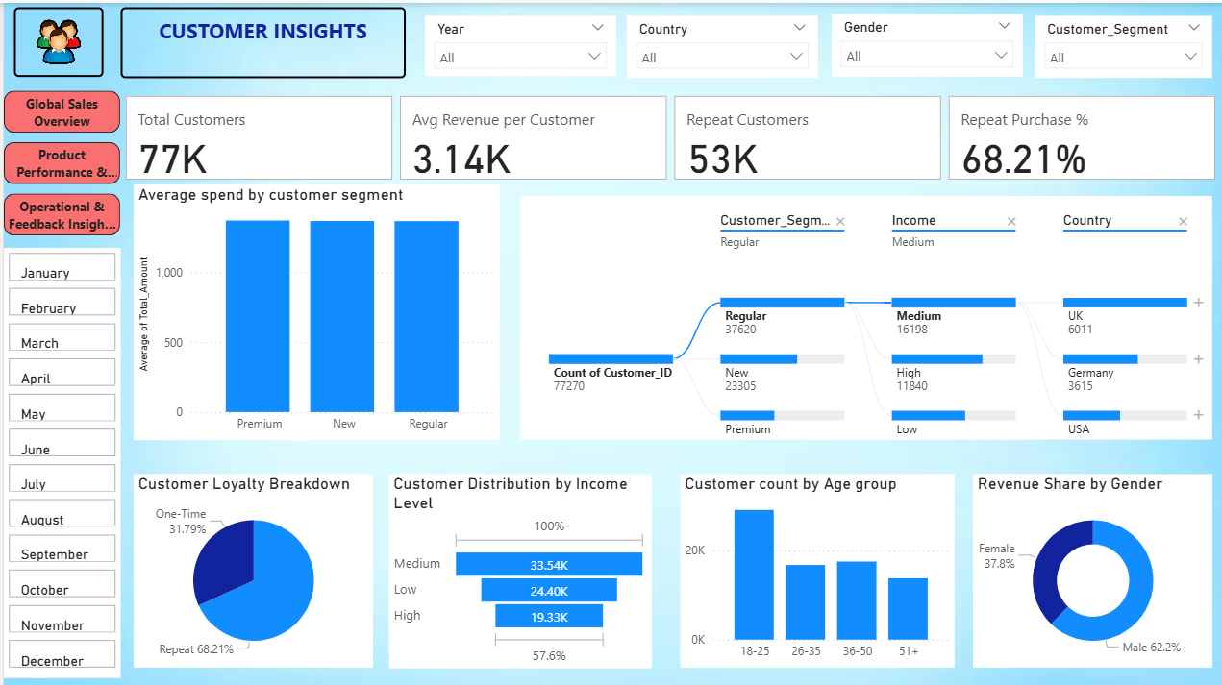
DASHBOARD 2 - CUSTOMER INSIGHTS
This dashboard provides a 360-degree view of our customer demographics and loyalty.
Key Insight: A high 68.21% repeat purchase rate proves a strong, loyal customer base.

Slide 11
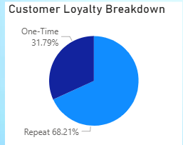
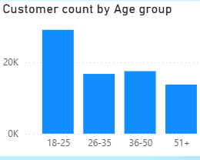
WHO IS OUR TYPICAL "REPEAT CUSTOMER"?
The "What": Our 68% repeat rate is the engine of the business.
The "Why" - The Profile:
Demographics: The typical loyal customer is a younger male (18-25) in the low-to-medium income bracket.
Purchasing Habits: They demonstrate loyalty through a mix of high-value Electronics purchases and consistent, high-volume spending on brands like Pepsi.
Recommendation: Target this core demographic with bundled promotions that connect popular grocery items with higher-margin electronics.

Slide 12
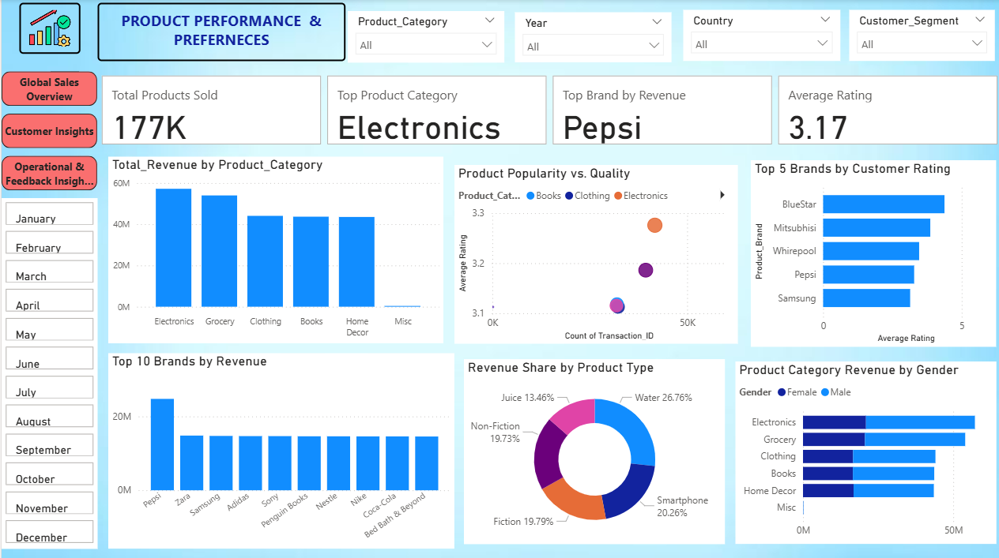
DASHBOARD 3 - PRODUCT PERFORMANCE & PREFERENCES
This dashboard analyzes product and brand performance.
Key Insight: A "volume vs. value" dynamic. 'Electronics' is the top category, but 'Pepsi' is the top brand.

Slide 13
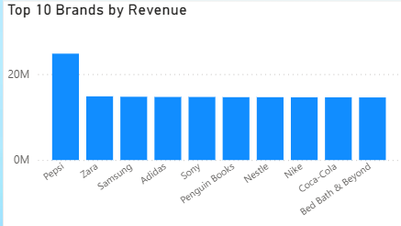
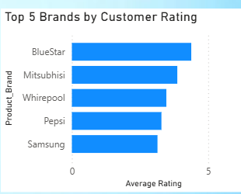
THE DISCONNECT BETWEEN QUALITY AND POPULARITY
The "What": The data shows that our best-selling brands (like Samsung) are not our best-rated brands (like BlueStar).
The "Why":
Mass-Market Hits (e.g., Samsung): Have a huge customer base and high loyalty, but average ratings (3.14).
Niche Favorites (e.g., BlueStar): Have a small, dedicated customer base that is extremely satisfied (4.38 rating) and highly loyal (85% repeat rate).
Recommendation: Adopt a two-tier marketing strategy: "volume" marketing for mass-market brands to acquire new customers, and "quality" marketing for niche brands to upsell to the existing loyal fanbase.

Slide 14
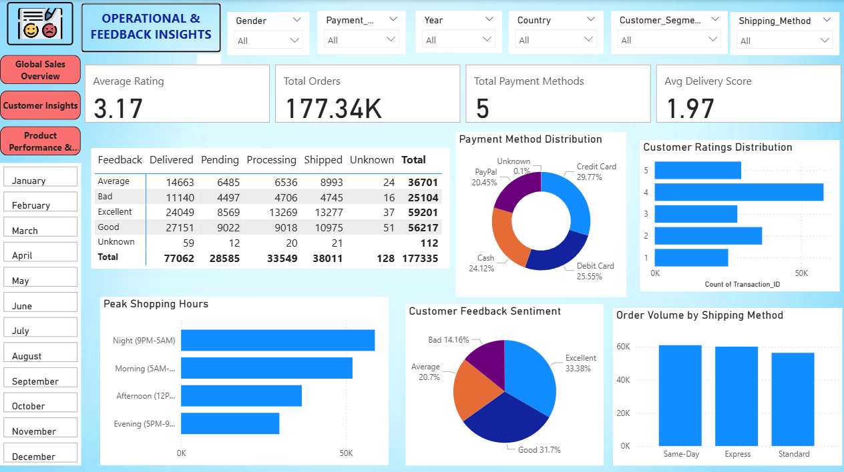
DASHBOARD 4 - OPERATIONAL & FEEDBACK INSIGHTS
This dashboard tracks operational efficiency and customer satisfaction.
Key Insight: A significant 14.16% "Bad" feedback rate is a major concern.

Slide 15
FINAL RECOMMENDATIONS & BUSINESS IMPACT
BOOST TRAFFIC IN FEBRUARY: Launch marketing campaigns in late January to counter the seasonal dip in customer traffic.
REPLICATE THE USA MODEL: Focus on building loyalty in other markets by promoting high-volume grocery items to younger demographics.
TARGET LOYAL CUSTOMERS: Create bundled promotions (e.g., Electronics + Grocery) for the core 18-25, low-to-medium income demographic.
IMPROVE POST-DELIVERY EXPERIENCE: Investigate the reasons for the high "Bad" feedback on delivered orders to address potential product quality or delivery issues.
Final Statement: "Implementing these data-driven recommendations will lead to increased customer retention, optimized regional marketing, and improved operational efficiency, providing a significant competitive advantage."

Slide 16
THANK YOU

